Slide 1

Behavrix
Behavrix
Human Risk Intelligence Platform
80% of breaches are caused by people — not firewalls, not software. We make human behavioral risk visible.
Try Behavrix Live
01

Slide 2
Behavrix
80%
of breaches caused by human behavior
$9.5T
annual global cybercrime cost
The
Problem
$25K
avg consulting engagement cost
6 wks
to get one vendor risk assessment
02

Slide 3
Behavrix
Behavrix vs Alternatives
Select org type
1
IN
AI analyzes 270 records
Get Human Risk Report
2
AI
90 sec · $0.002 · No contract
Consulting firm
3
vs
6 weeks · $25,000
03

Slide 4
Behavrix
270
Real attack records
The Magic,
Simplified
90 sec
Avg report time
4
Behavioral archetypes — MITRE
04

Slide 5
Behavrix
Pay Per Report
Solo analysts. $0.50 per report. No commitment. On-demand human risk reports for vendor assessments.
Business
Model
Team Subscription
Enterprise API
Security teams. $299 per month. Unlimited reports across all 10 organization types.
GRC platforms. $2,000 per month. White-label API plus custom personas for embedding.
05

Slide 6
Behavrix
Go-to-Market
Strategy
Direct Outreach
Community Growth
Boston financial institutions via MA State Lottery co-op and NEU alumni at State Street. Goal: 10 paying customers in 90 days.
Consulting Partners
ISC2, ISACA, r/netsec communities. Free reports for practitioners. 20% conversion target. Goal: 100 users, 20 paying.
GRC consulting firms white-label Behavrix. They charge $25K — we enable it in 90 seconds. Goal: 3 partnerships in year 1.
06

Slide 7
Behavrix
Competition
KnowBe4
Prevalent TPRM
Drata / Sprinto
Trains employees on phishing. No vendor risk reports. 25-seat minimum. $2.79-3.75/user/month.
Questionnaire-based compliance. Misses human behavior entirely. Enterprise contracts, weeks to implement.
Compliance automation for SOC 2. No behavioral modeling. Built for auditors, not analysts.
❌
No behavioral archetypes
❌
No MITRE mapping
✅
Behavrix wins all 6 factors
07

Slide 8
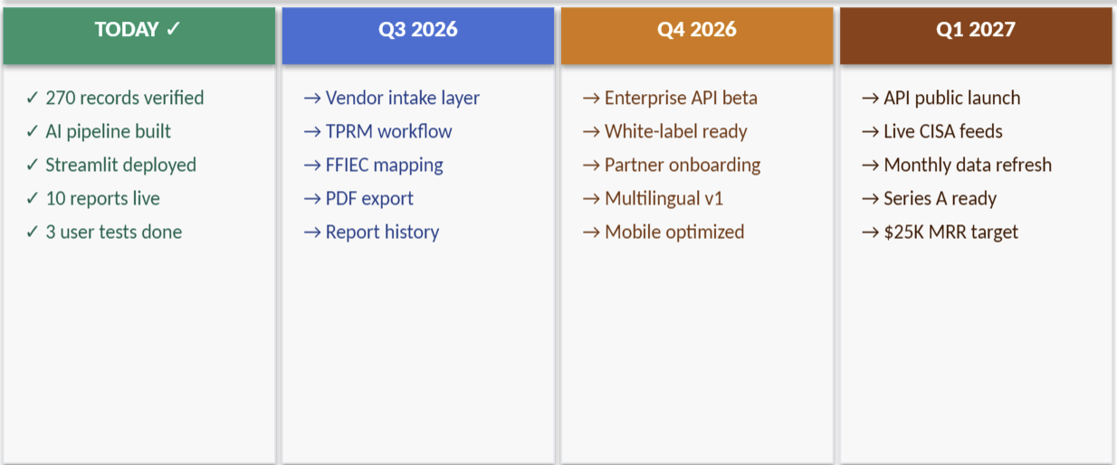
Behavrix
Development Plan
behavrix.ai
08

Slide 9
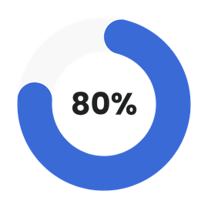
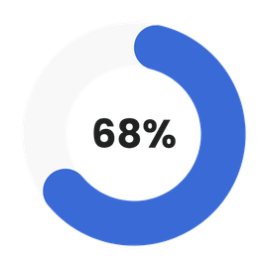
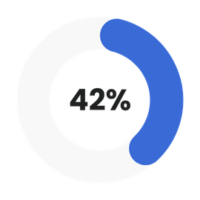
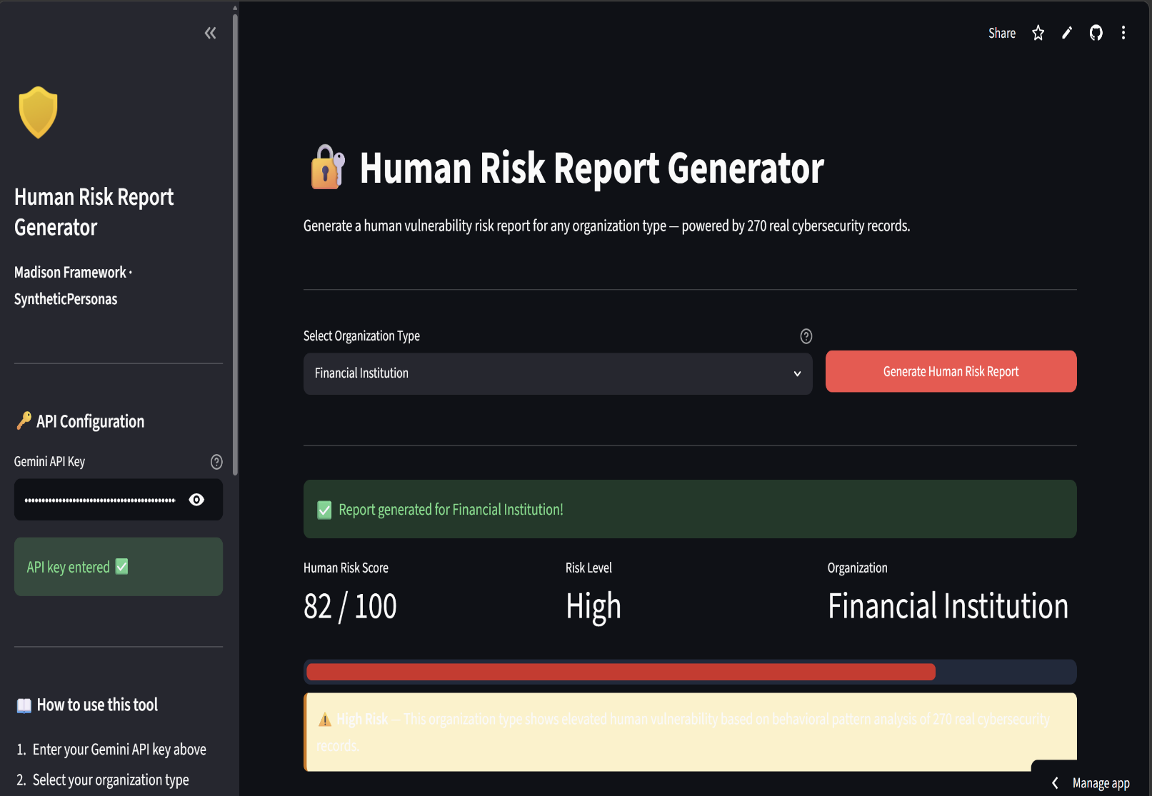
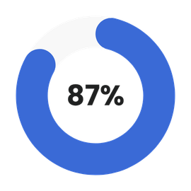
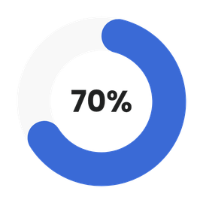
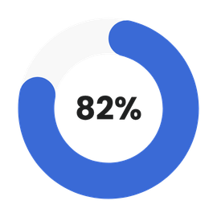
Behavrix
Proof of Concept
Records analyzed
Report time
Cost per run
Industries covered
User tests passed
App is live now
Sample output — Financial Institution: Human Risk Score 82/100 High Risk.
09

Slide 10
Behavrix
The
Ask
$150,000 seed funding · 15% equity · Advisory board seat | $60K Engineering · $40K Data · $30K GTM · $20K Operations | 90 days: 10 paying customers · 12 months: $25K MRR · 18 months: Enterprise API | The human risk gap is real. The product is live.
Are you in?
behavrix.ai
10

